Slide 1
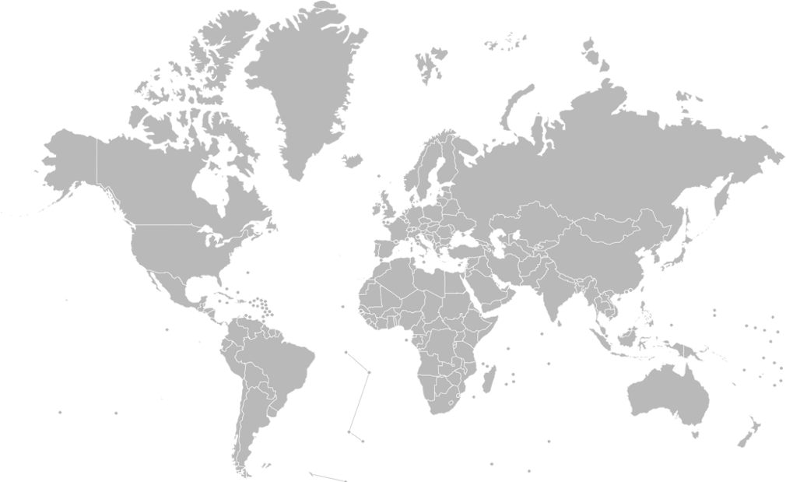
Trade Protectionism understanding the long and short-terms
Jonathan D. Moyer
David K. Bohl
Barry B. Hughes
Frederick S. Pardee Center for International Futures
Josef Korbel School of International Studies
University of Denver

Slide 2
Globalism Revival v.
Nativist Victory to 2035
Cumulative $52 trillion more GDP
(equivalent to global GDP in 2000)
48 million fewer people in extreme poverty (population size equivalent to Colombia in 2016)
Globalism Revival
Middle class grows by 95 million
(population size equivalent to Viet Nam in 2016)
Trade Stagnates
Nativist Victory
8% reduction in domestic conflict
(16 fewer states with violent insurrection)

Slide 3
Tariff on Chinese manufactured goods
Short-Run Best Case
Short-Run Worst Case
45%
No retaliation and
fully mobile factors
Retaliation and
immobile factors
2.5 percent increase in production
400 thousand additional jobs
0.5 percent increase in GDP
0.9 percent reduction in production
140 thousand fewer jobs
0.2 percent reduction in GDP
Household consumption
$550 billion less in the US
$120 billion less in China
Cumulative GDP
$5.5 trillion lower in the US
$4.2 trillion lower in China
Trade declines by a cumulative $5.7 trillion
By 2035
Notes:
Short-Run Base Case
Retaliation and partially mobile factors
0.5 percent reduction in production
90 thousand fewer jobs
0.1 percent reduction in GDP

Slide 5
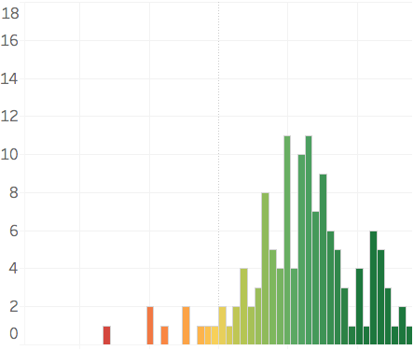
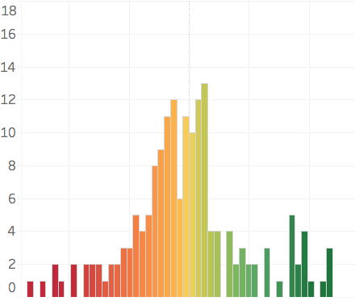
18
16
14
12
10
8
6
4
2
0
Dependent on China
Dependent on USA
18
16
14
12
10
8
6
4
2
0
Dependent on China
Dependent on USA
Number of countries
1990
2014

Slide 7
Disrupts Trade Networks:
Supply Chains
Undermine Comparative Advantage
National
Increased Trade and Capital Protectionism
Re-allocation of Capital and Labor
Clay v. Putty Capital
Benefits Scarce Factors
High Skilled Labor v. Low Skilled
Labor v. Capital
Sub-national

Slide 8
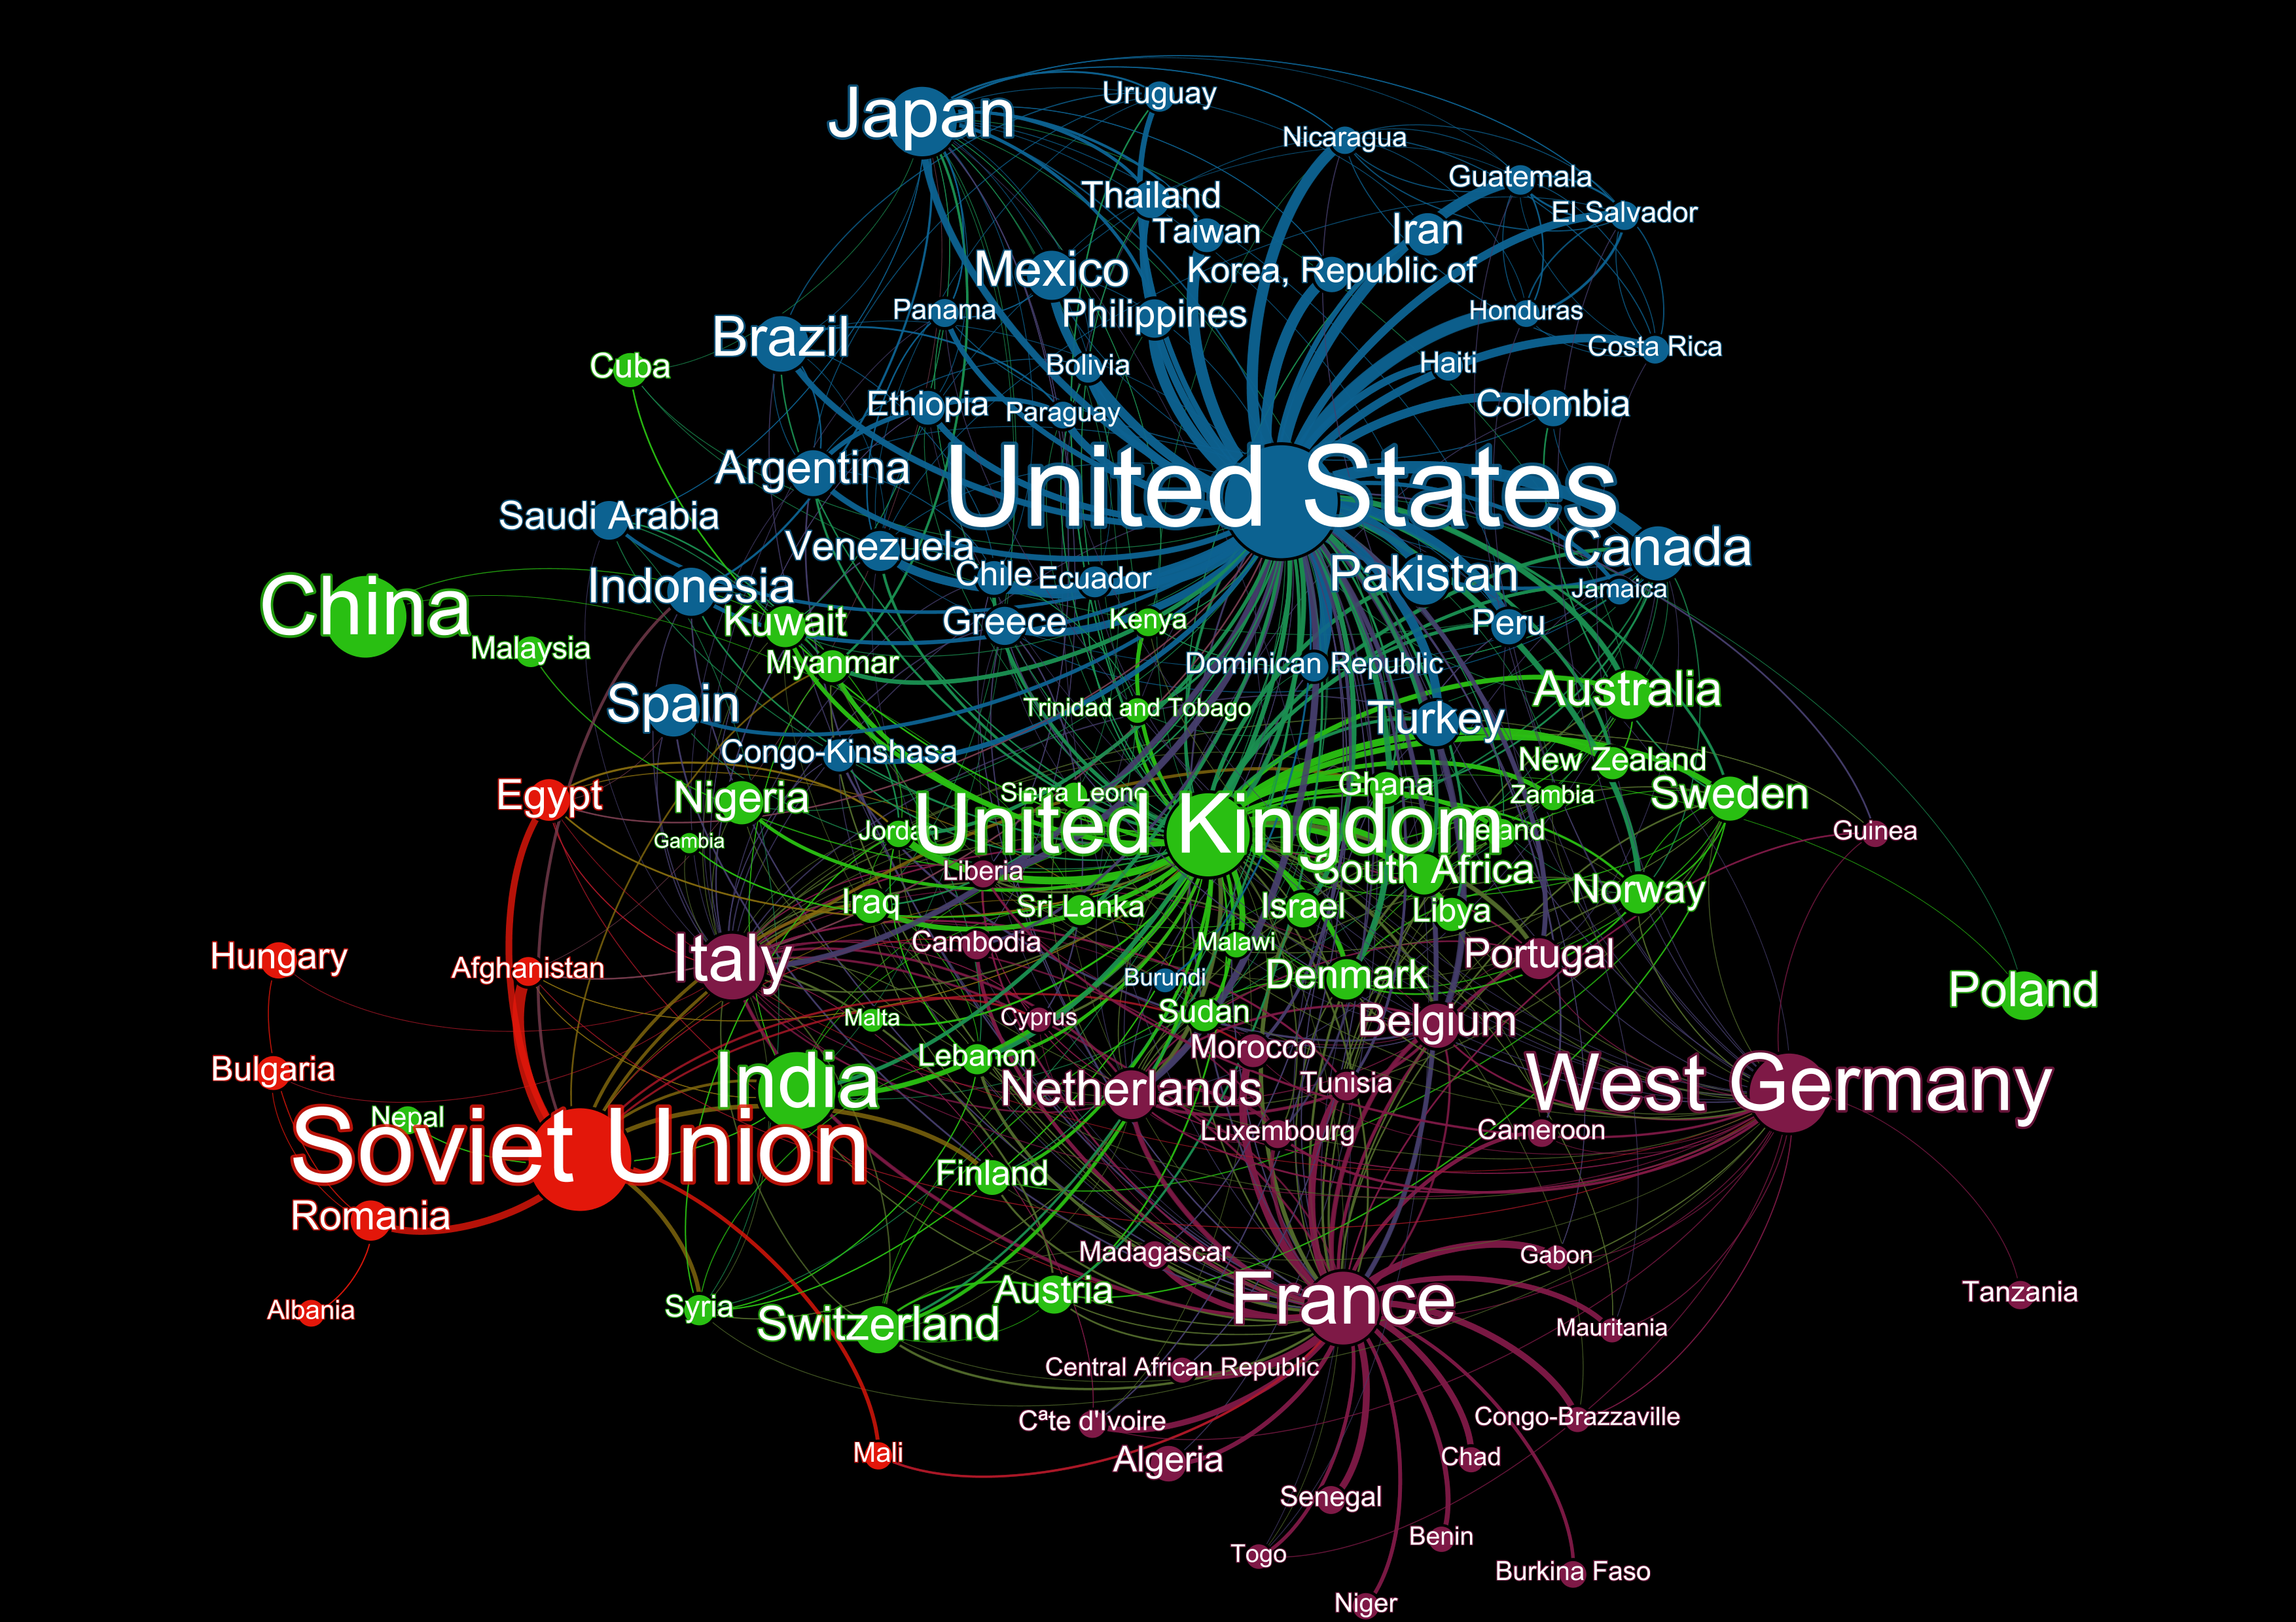
This network map was created using bilateral data measuring the ability of states to formally influence one another. It is built across three dimensions (economic, political, security) and was originally created for the US government.
1965

Slide 9
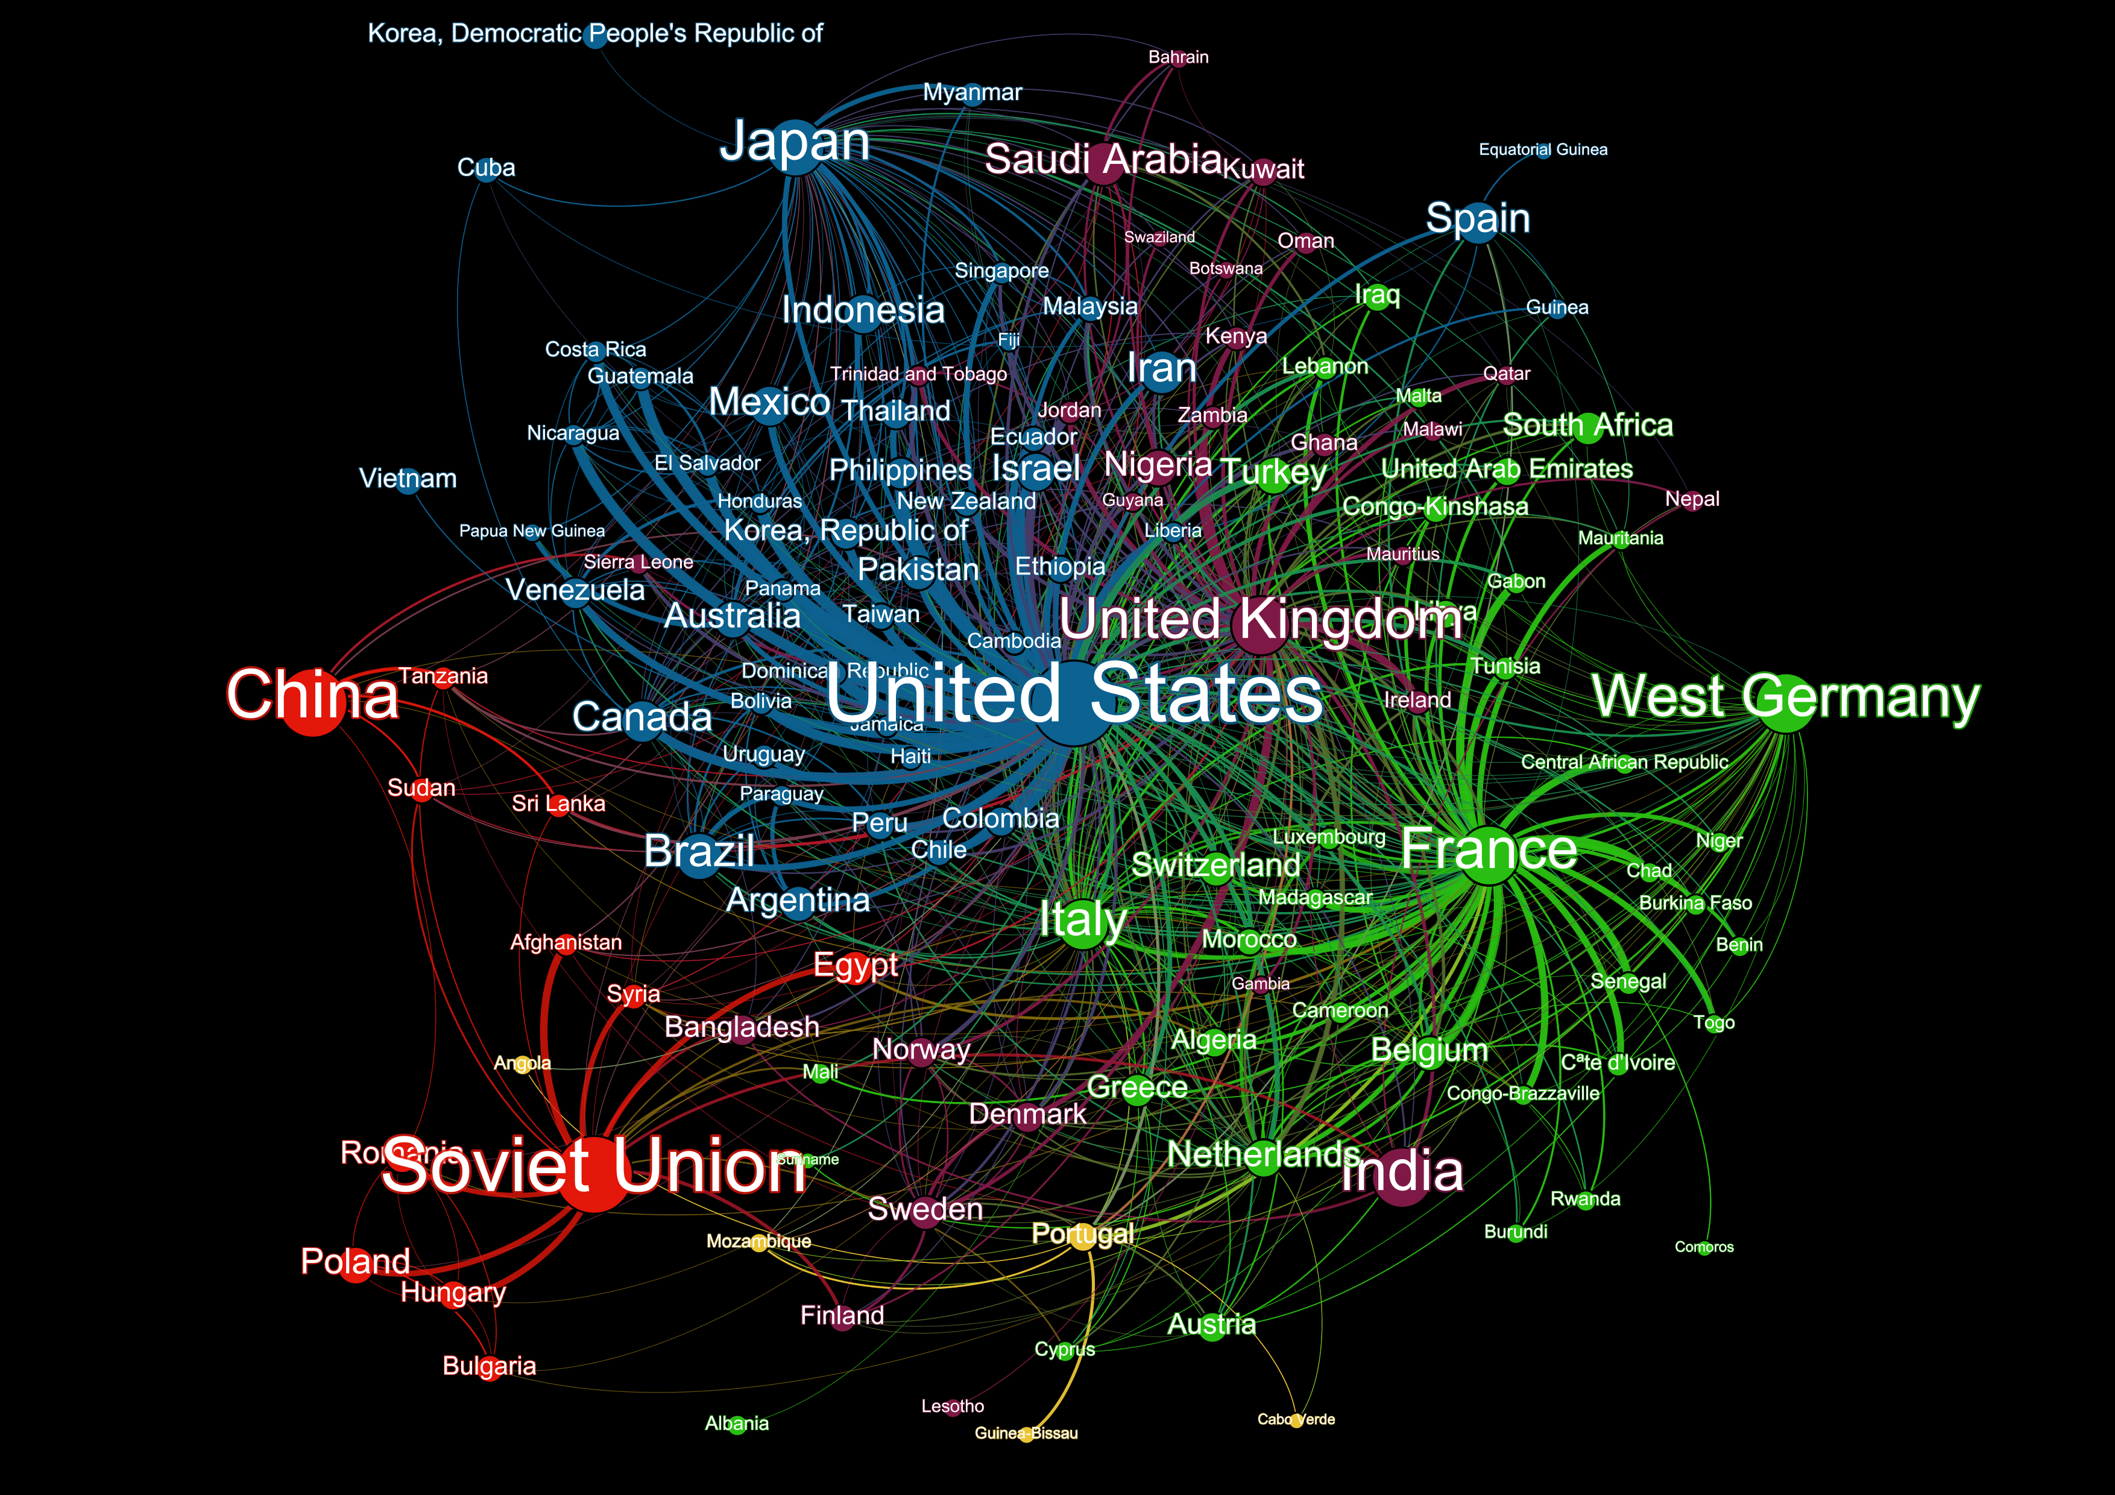
This network map was created using bilateral data measuring the ability of states to formally influence one another. It is built across three dimensions (economic, political, security) and was originally created for the US government.
1975

Slide 10
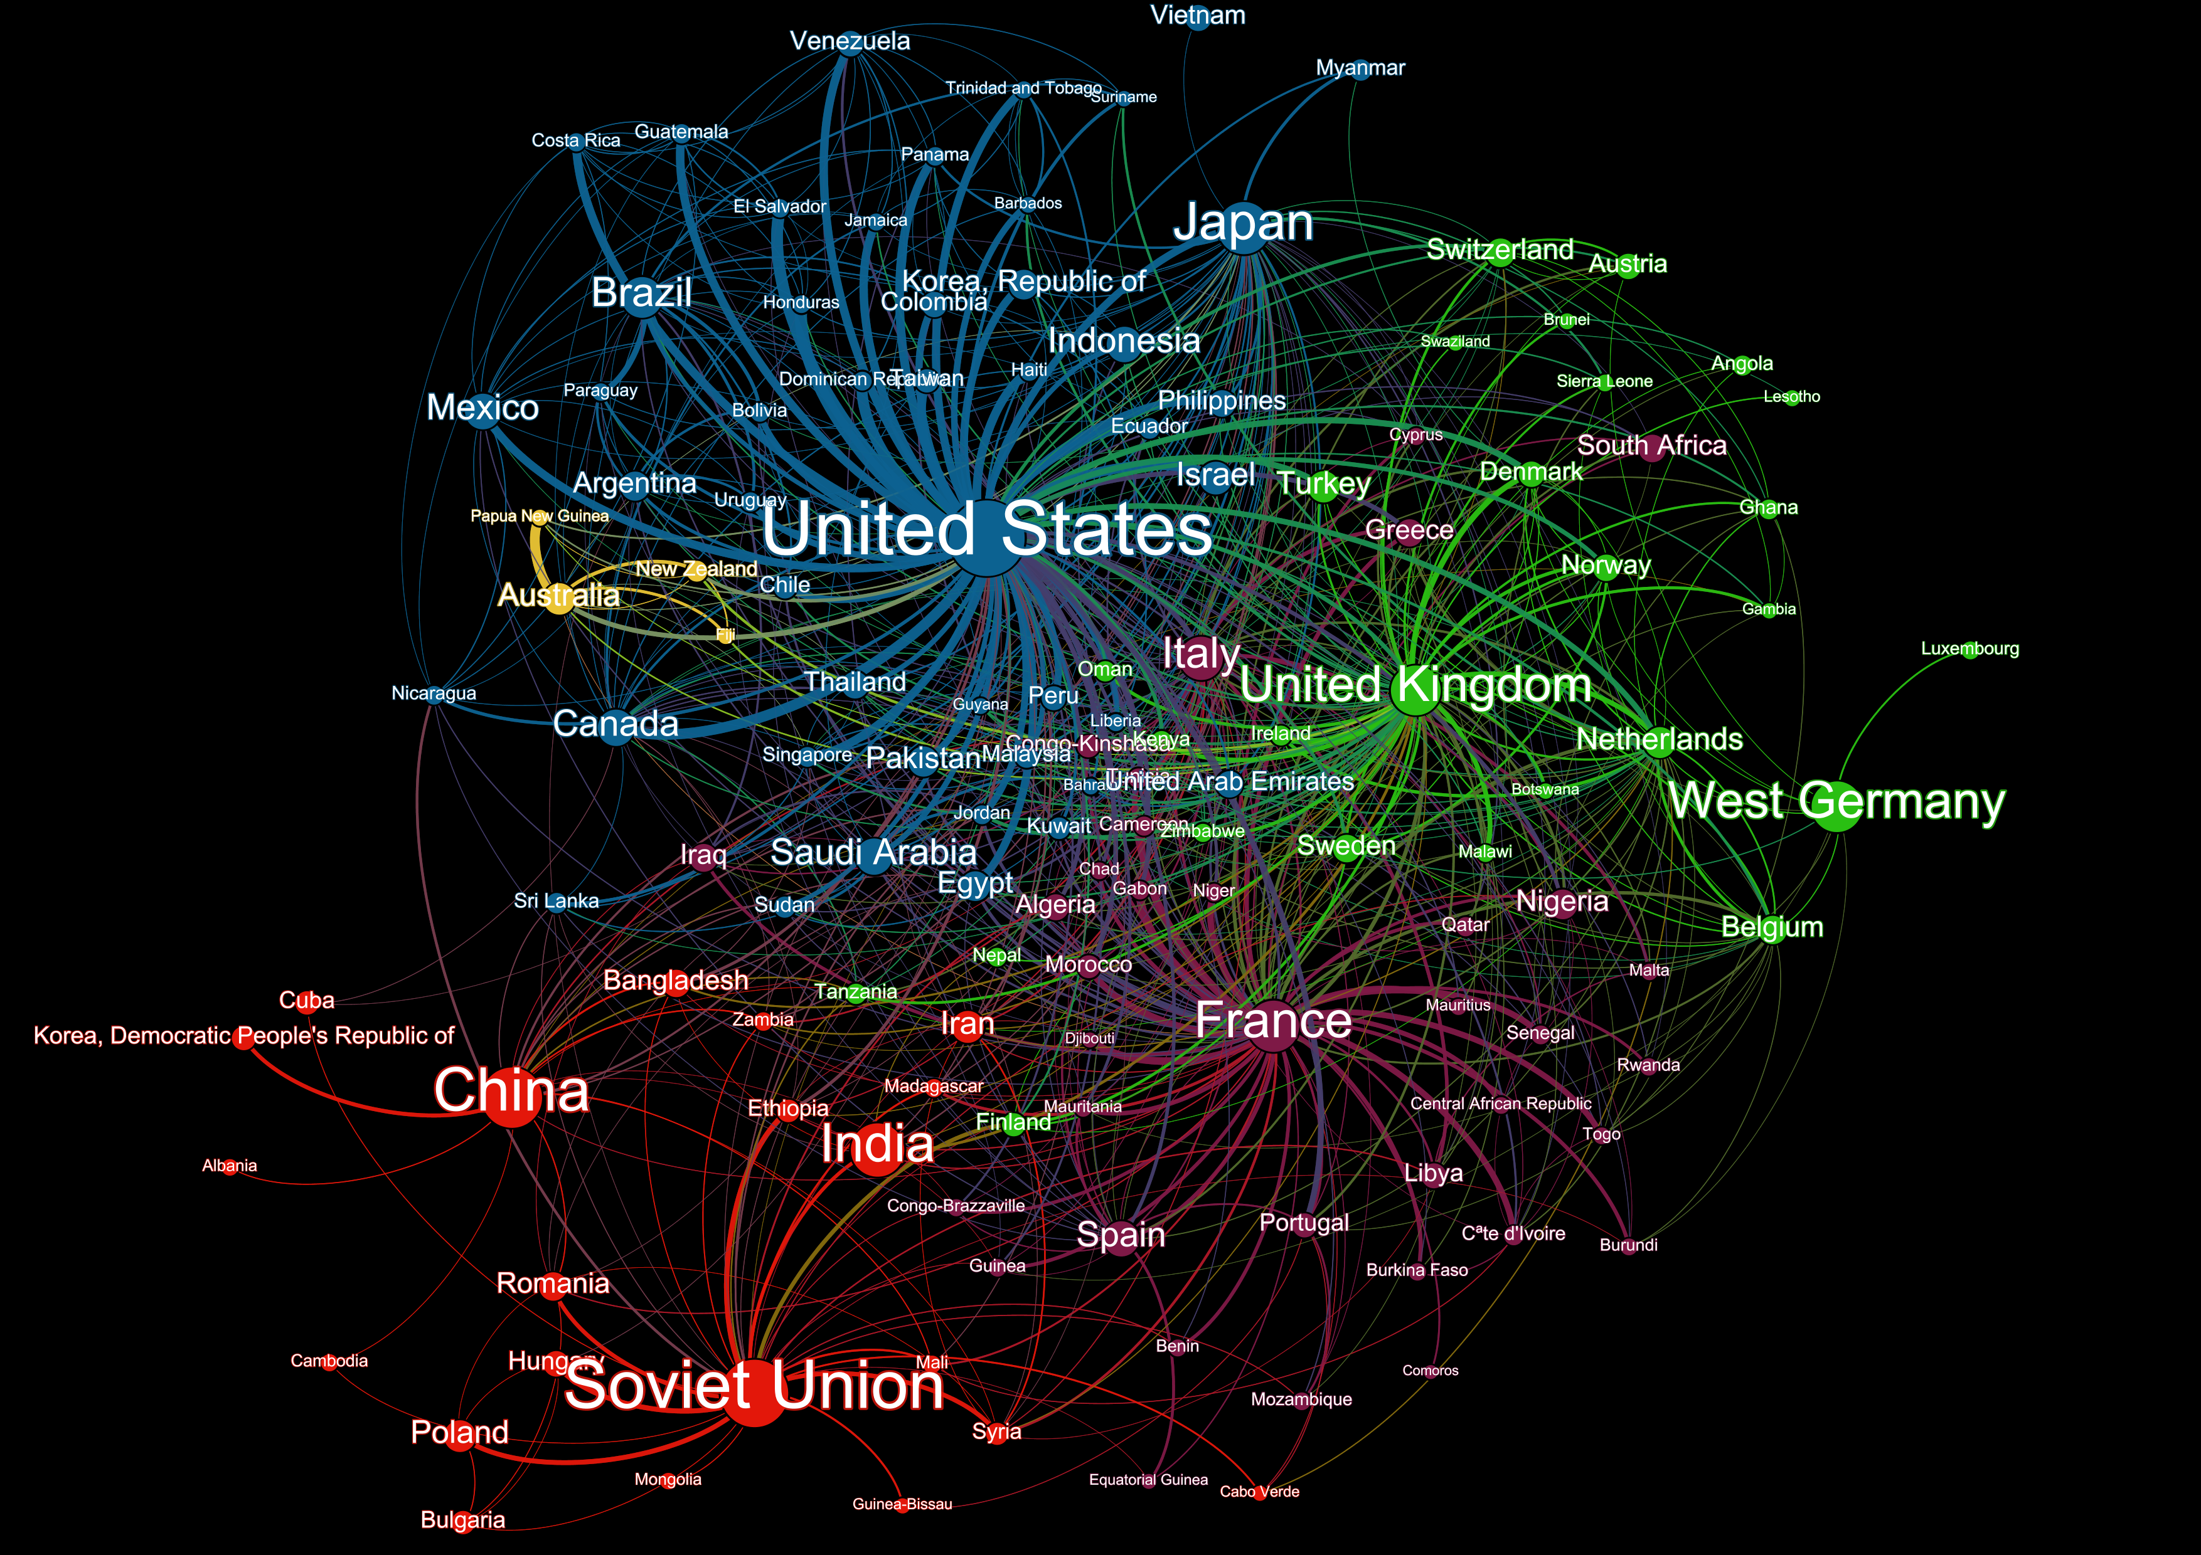
This network map was created using bilateral data measuring the ability of states to formally influence one another. It is built across three dimensions (economic, political, security) and was originally created for the US government.
1985

Slide 11
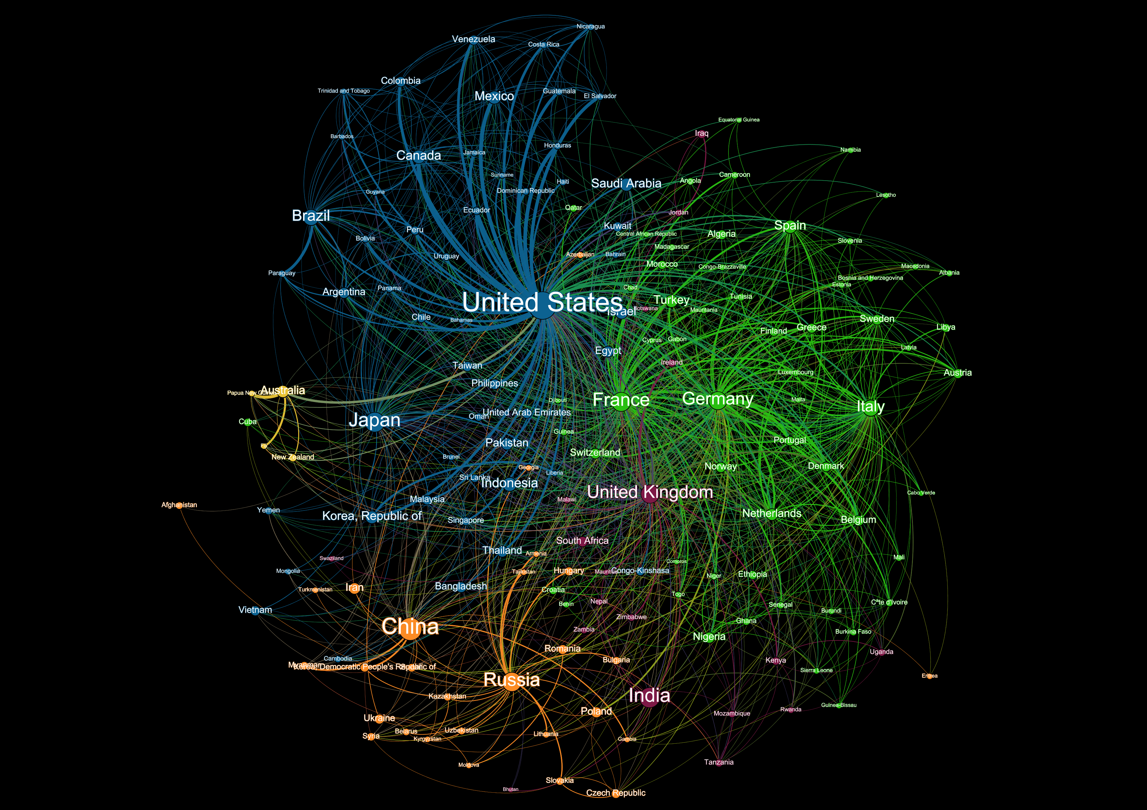
This network map was created using bilateral data measuring the ability of states to formally influence one another. It is built across three dimensions (economic, political, security) and was originally created for the US government.
1995

Slide 12
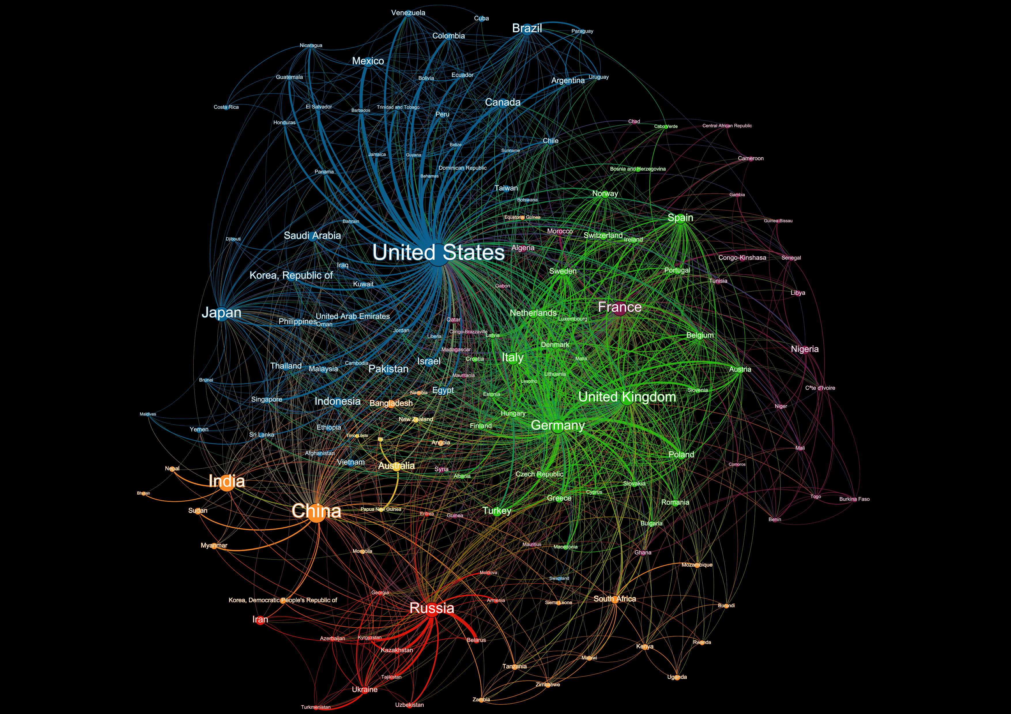
This network map was created using bilateral data measuring the ability of states to formally influence one another. It is built across three dimensions (economic, political, security) and was originally created for the US government.
2005

Slide 13
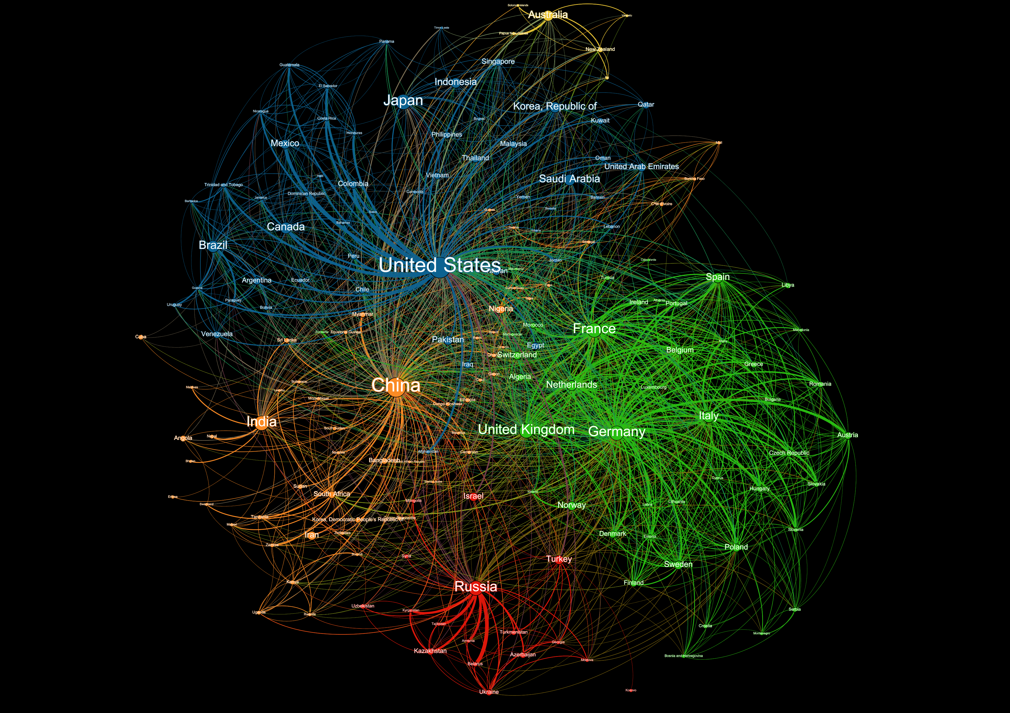
This network map was created using bilateral data measuring the ability of states to formally influence one another. It is built across three dimensions (economic, political, security) and was originally created for the US government.
2015

Slide 14
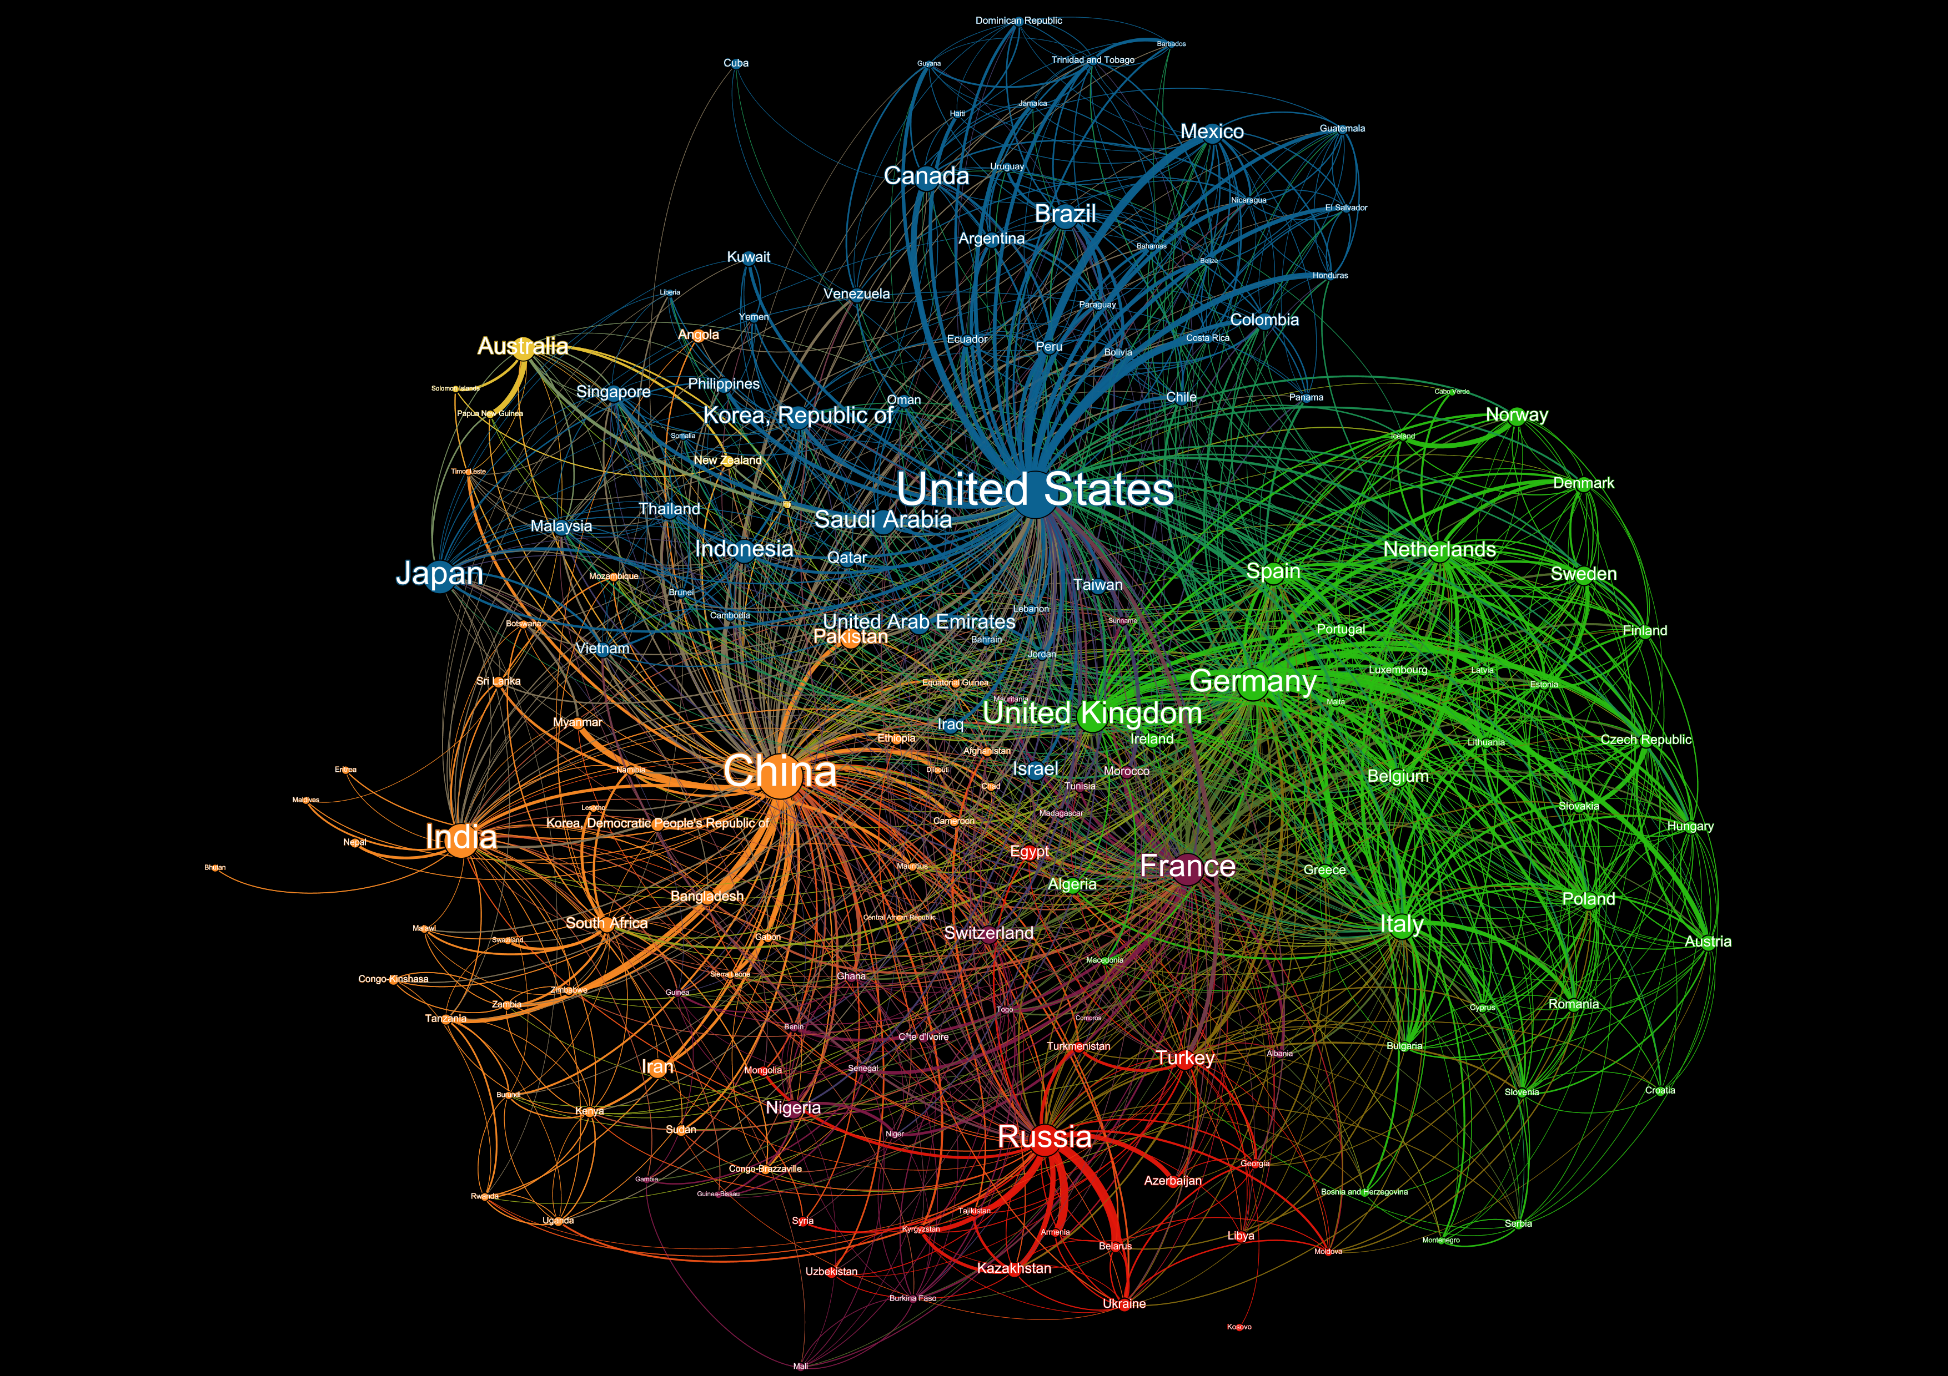
This network map was created using bilateral data measuring the ability of states to formally influence one another. It is built across three dimensions (economic, political, security) and was originally created for the US government.
2020
Base Case

Slide 15
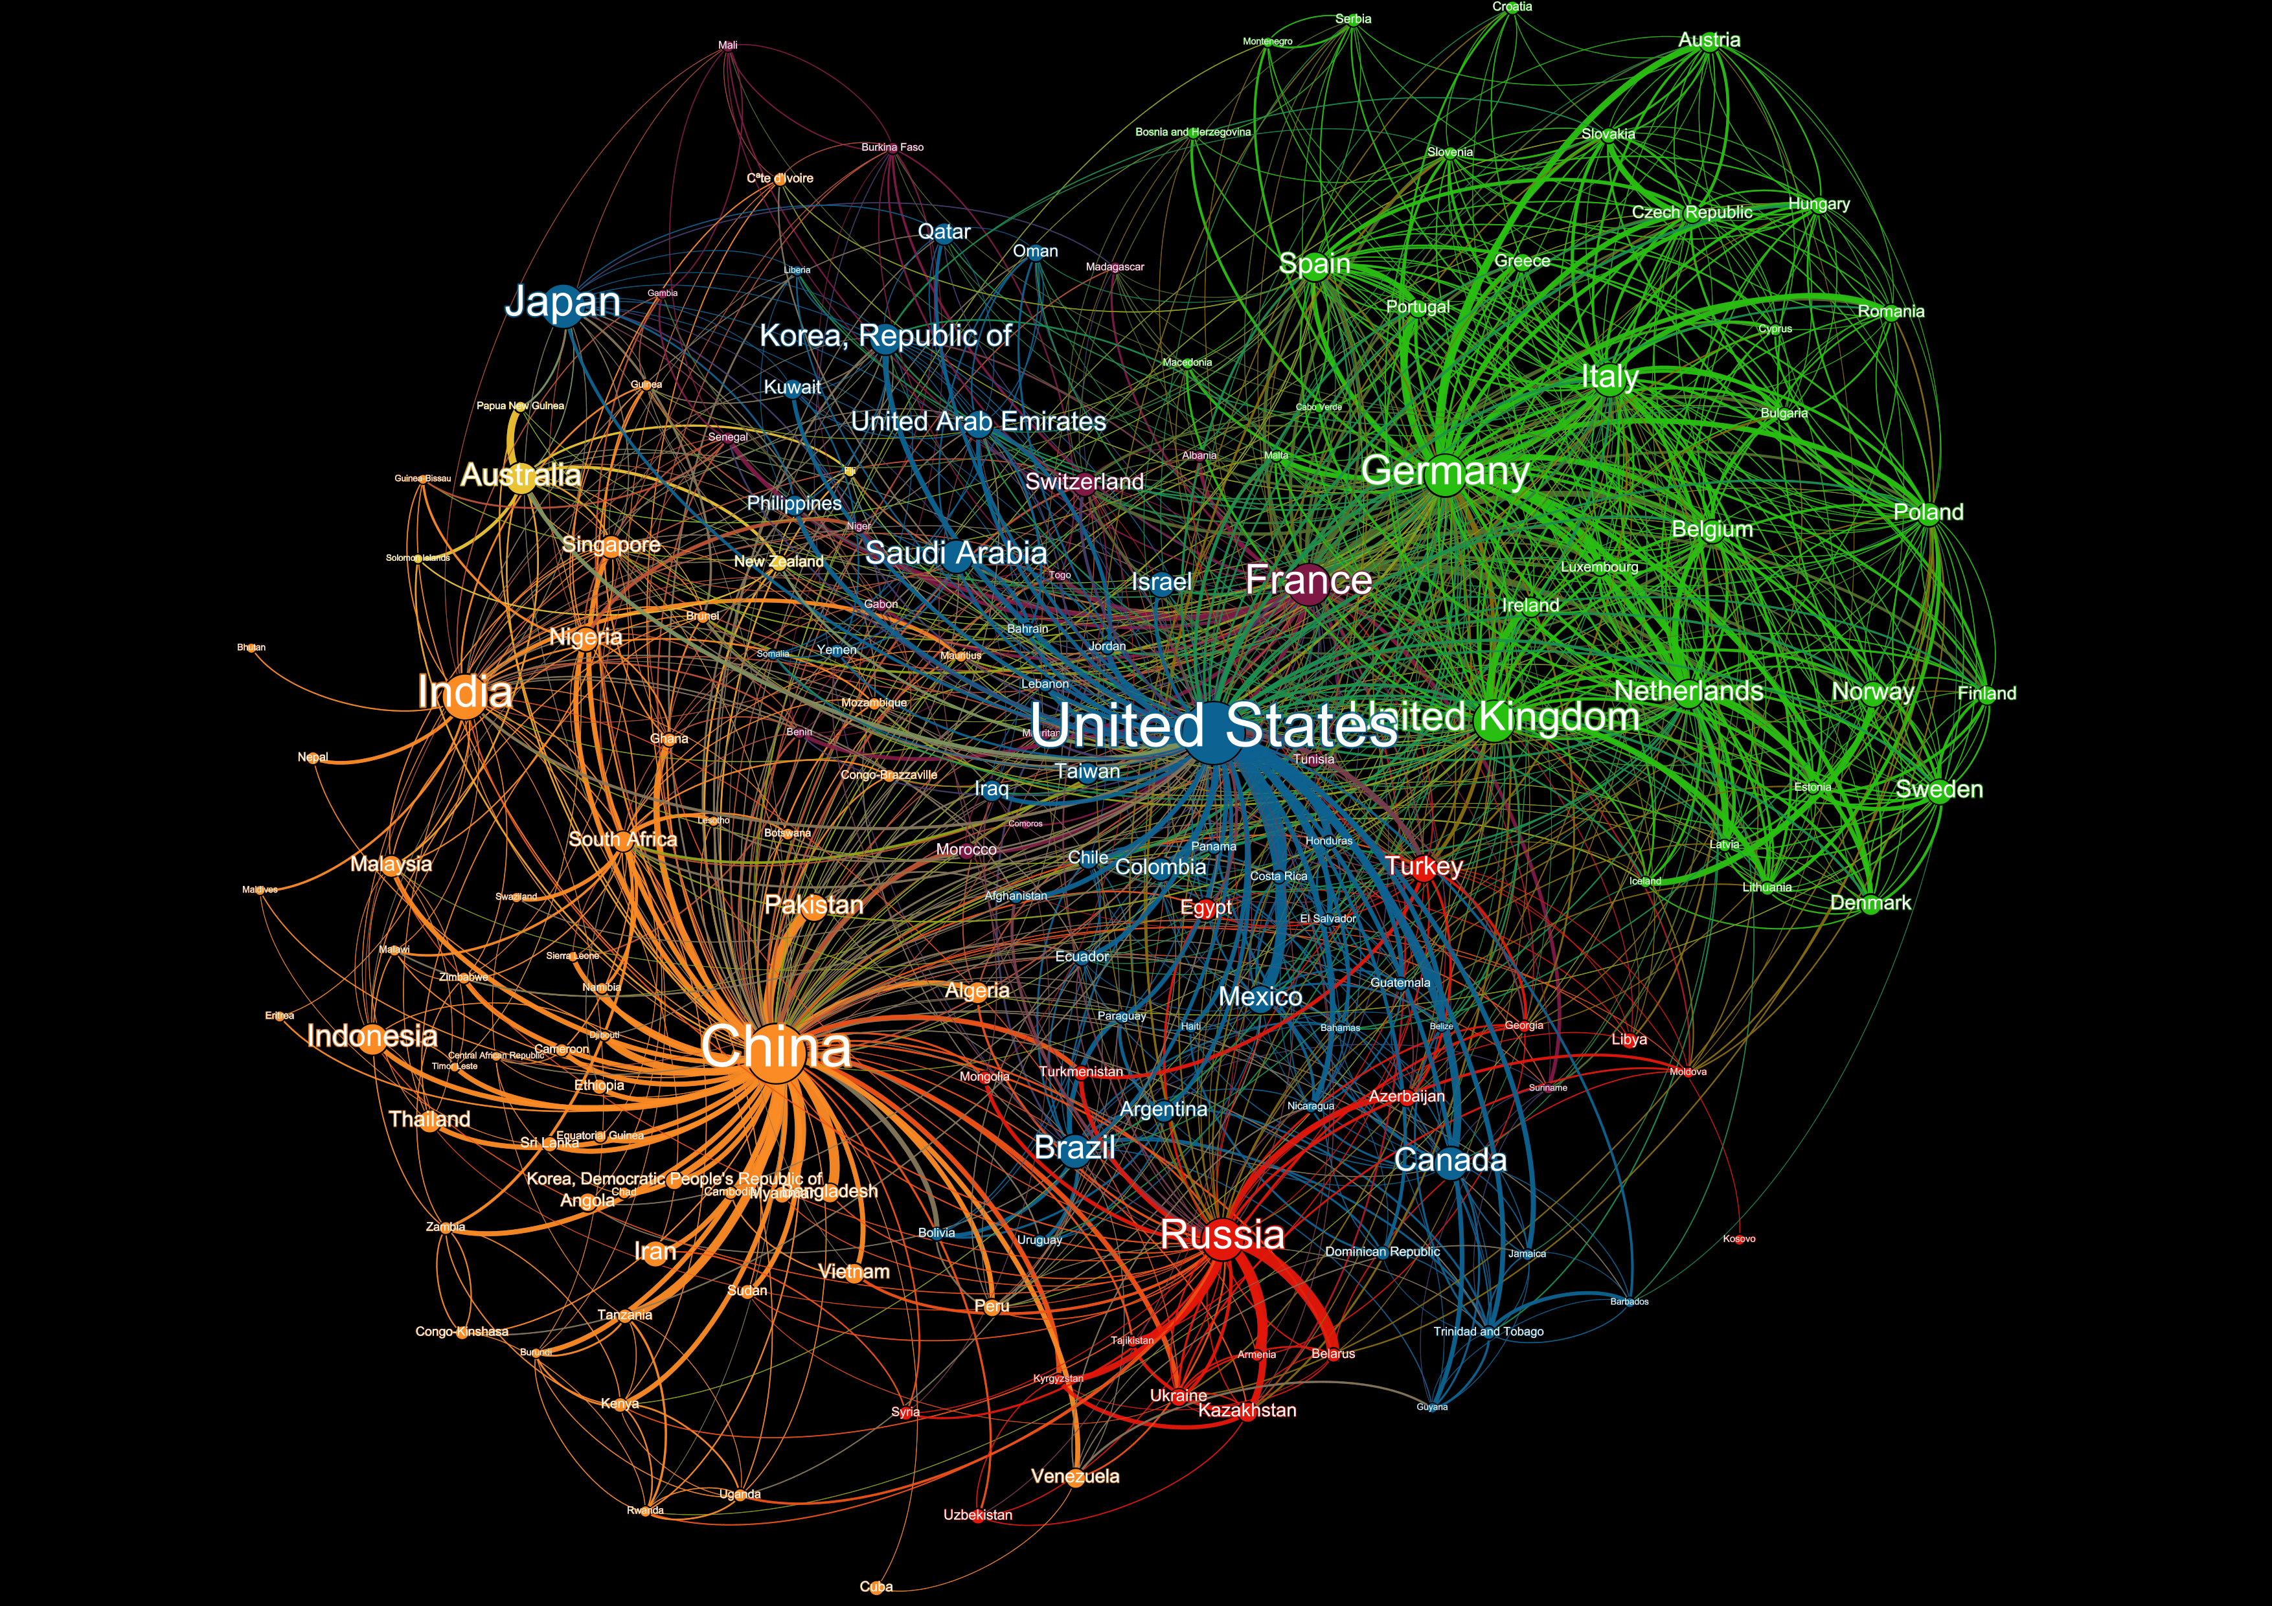
This network map was created using bilateral data measuring the ability of states to formally influence one another. It is built across three dimensions (economic, political, security) and was originally created for the US government.
2020
China Rising

Slide 16
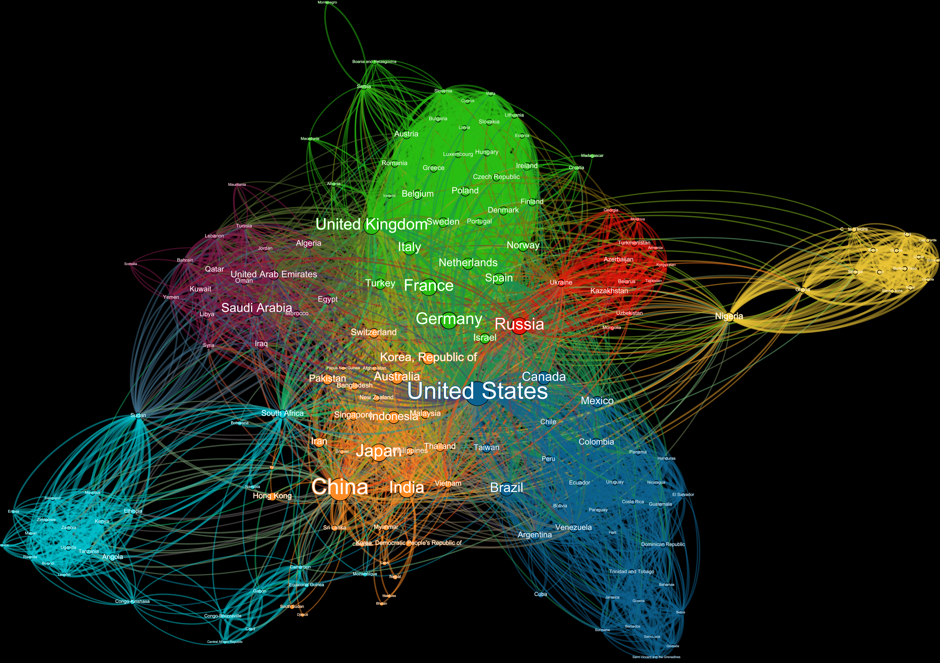
This network map was created using bilateral data measuring the strength of economic, political, and security ties between two countries. It was originally created for the US government.
2015

